Slide 1

Brightcove Gallery Essentials
Bob Bailey
bbailey@brightcove.com

Slide 2
Agenda
Introduction
Gallery Settings
Creating a New Site
Adding Objects to Pages
Adding Video to a Site
Setting Site Properties
Previewing & Publishing a Site

Slide 3
Introduction

Slide 4
What is Gallery?
Brightcove Gallery enables marketers to create engaging video portal experiences with best practices for SEO, responsive design, social sharing and conversion all in a single solution that can be implemented and updated in just minutes
Integrates closely with Video Cloud
No technical resources required
Over 100 out-of-the-box templates
Responsive design looks great on any device
Social sharing features to drive more traffic

Slide 5
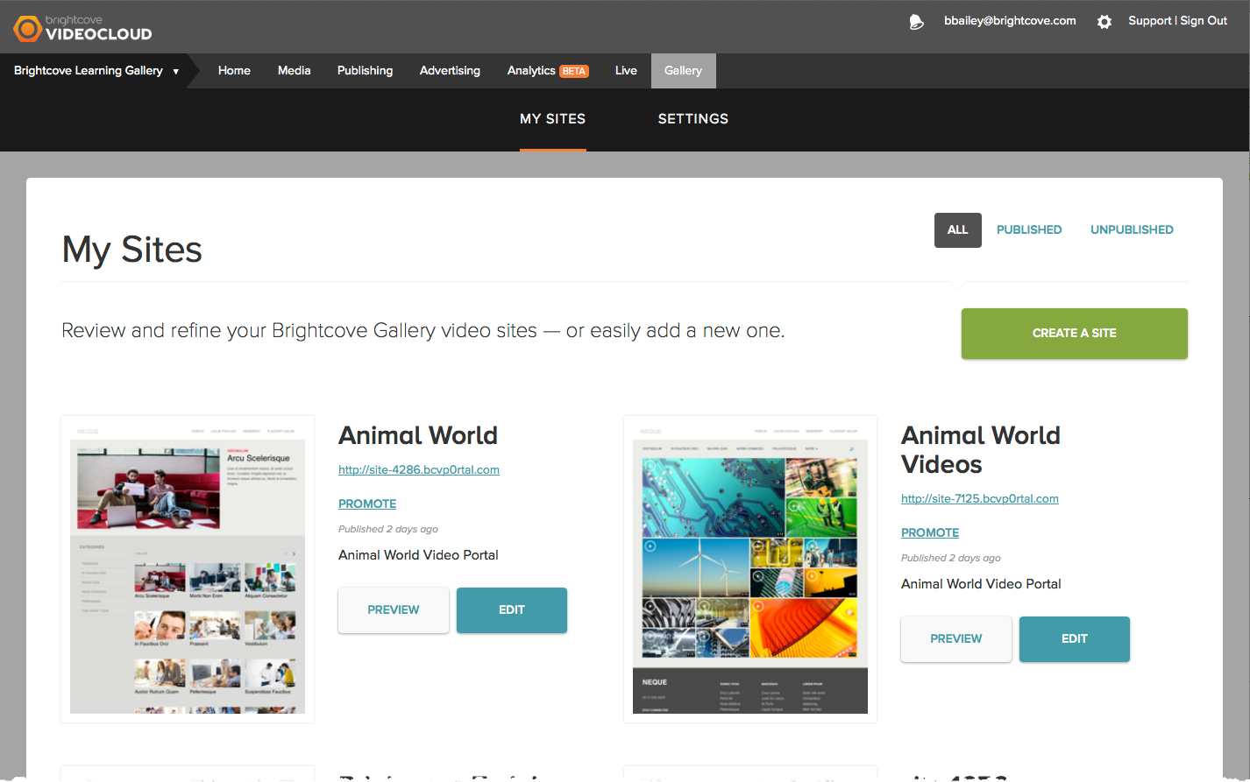
Navigating the Gallery Module

Slide 6
Gallery Settings

Slide 7
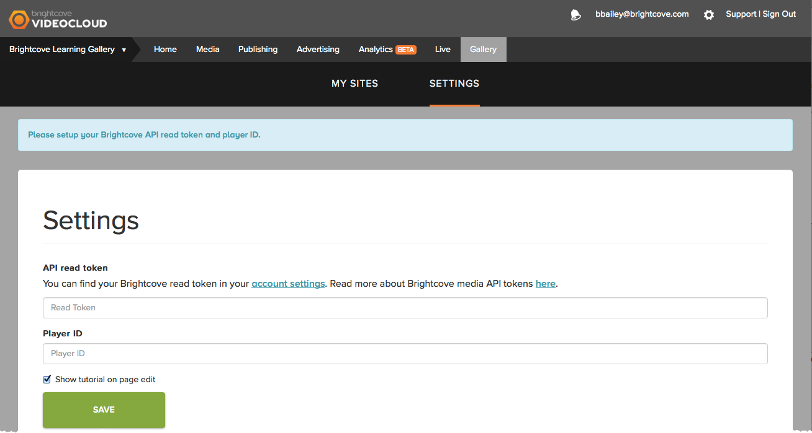
Configuring Gallery Settings
Gallery Settings must be configured before you can start using Gallery
API read token
Player ID

Slide 8
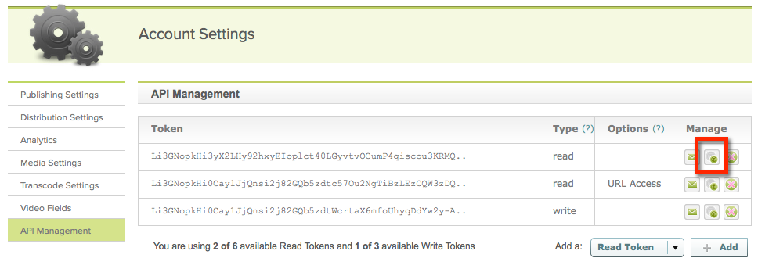
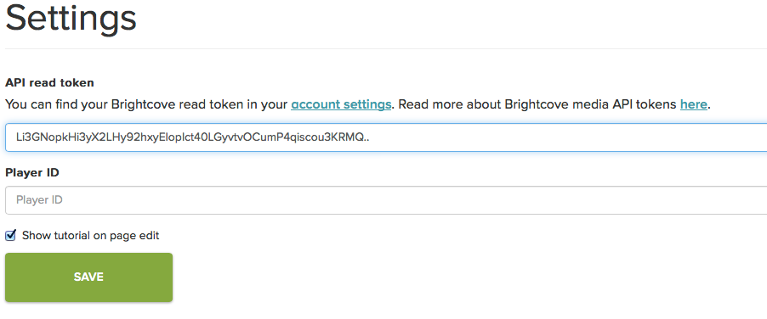
Configuring API Read Token
Gallery requires your Video Cloud API read token so it can access the videos and playlists in your account
To configure the API read token:
Click the account settings link or go to Account Settings > API Management
Copy the read token

Slide 9
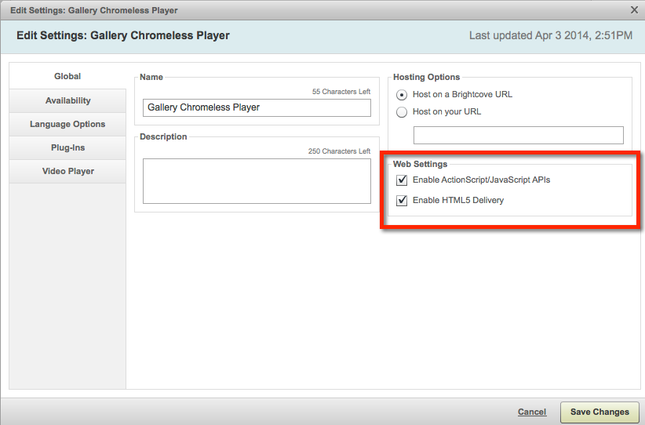
Configuring the Player ID
We recommend creating a dedicated player for your Gallery site
Only single video players are supported
Player should have these settings enabled

Slide 10
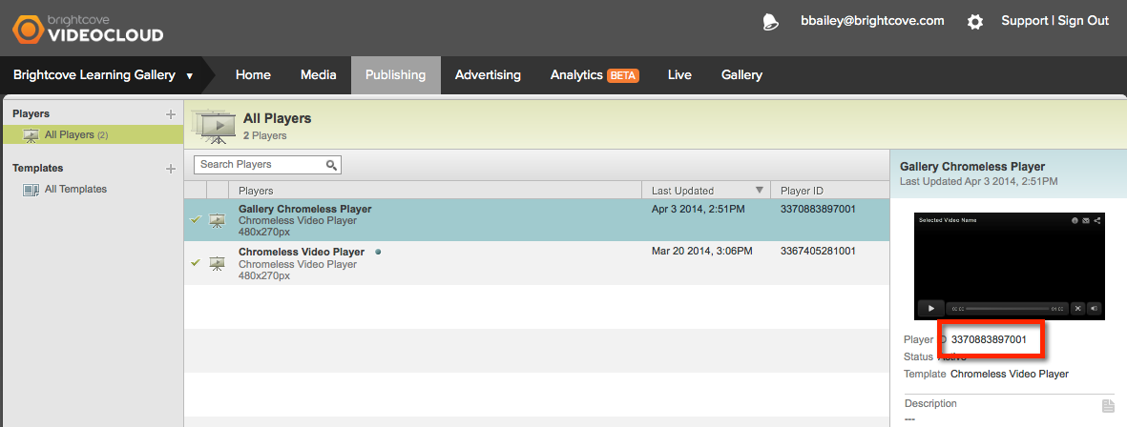
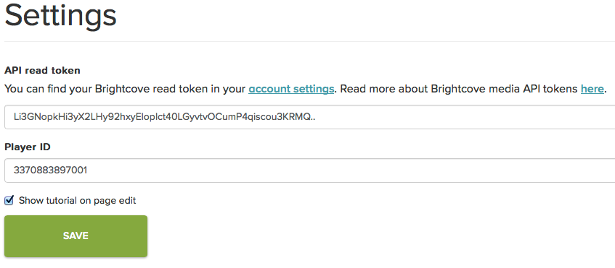
Configuring the Player ID
Gallery requires the player ID for the Video Cloud API player that will be used on your sites
To configure the player ID:
Open the Publishing module, locate the player to use
Copy the player ID

Slide 11
Creating a New Site

Slide 12
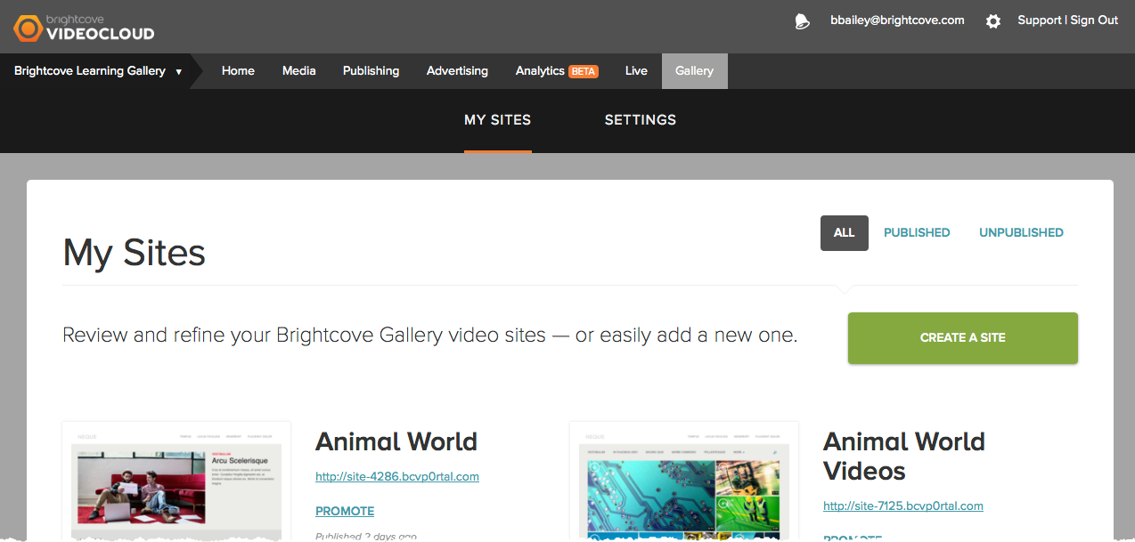
Creating a New Site
To create a new site, click CREATE A SITE

Slide 13
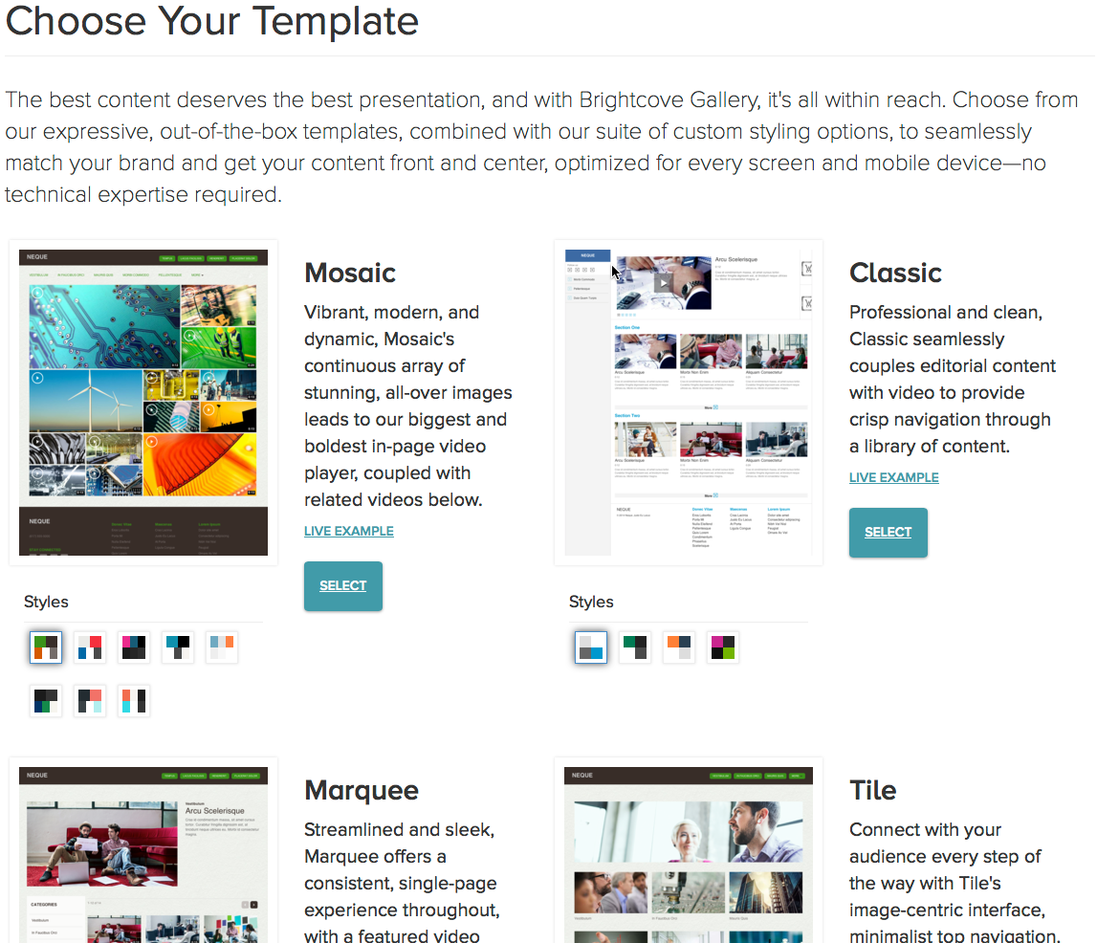
Creating a New Site
Select a template and a style
Styles can be changed later, templates can’t

Slide 14
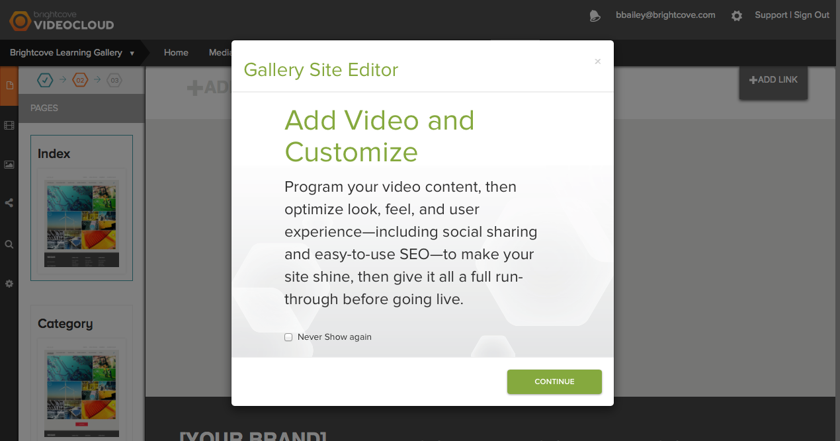
Gallery Site Editor
Used to add videos and customize the site

Slide 15
Adding Objects to Pages

Slide 16
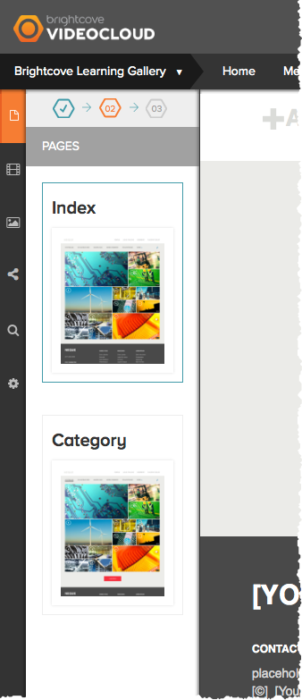
Page Navigation
Based upon the template that is selected, a set of pages templates will be available
Click on the page thumbnail to view/edit the page contents

Slide 17
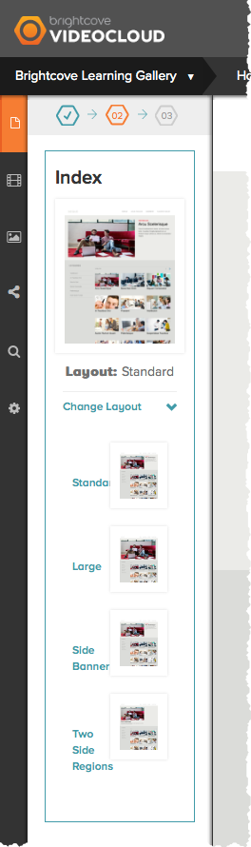
Editing the Player Layout
Some page templates provide the ability to change the player layout
Click Change Layout and select a new layout

Slide 18
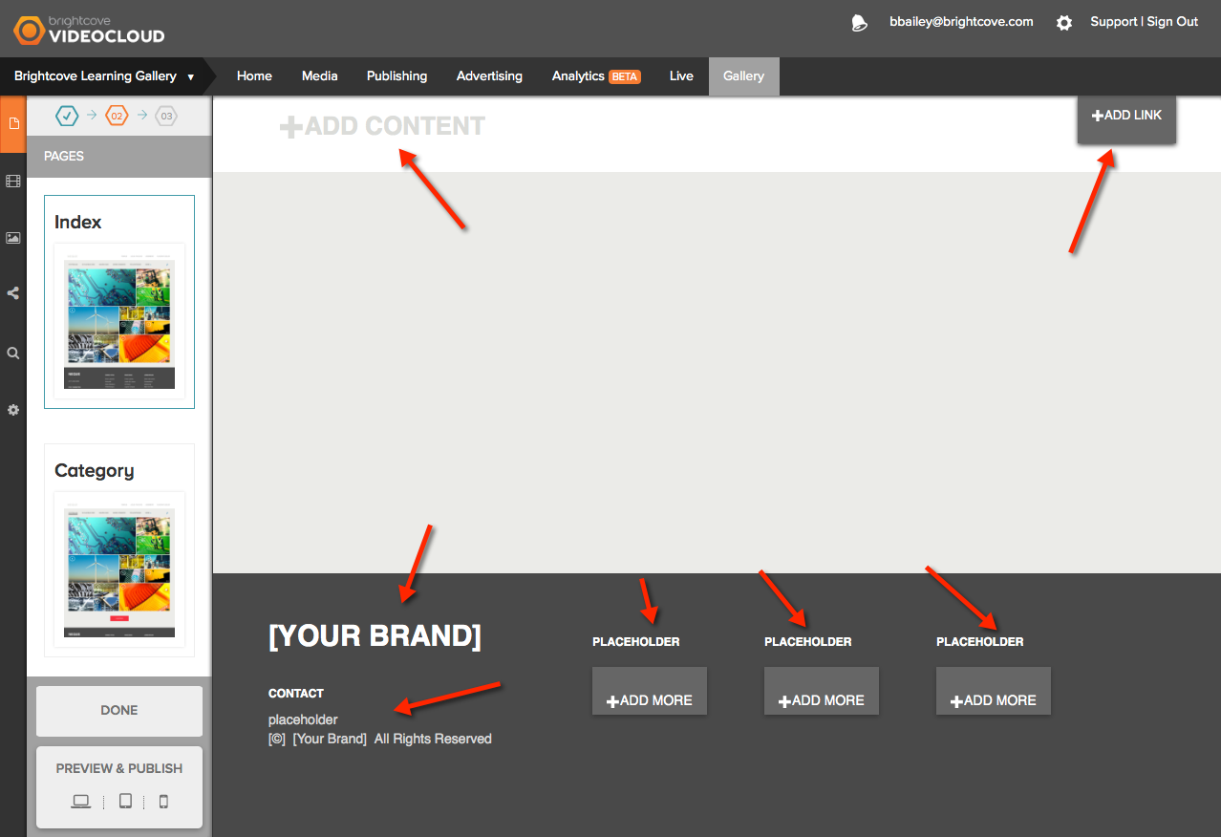
Editing the Page Content
Placeholders on the page indicate where images/text can be added
To add content, click a placeholder

Slide 19
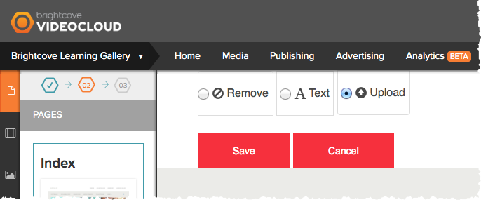
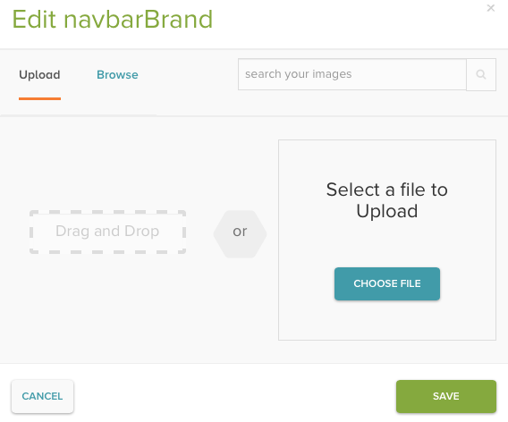
Adding an Image
Click a placeholder
Select Upload and then Save to add image placeholder
Click +ADD PHOTO link to browse and select an image

Slide 20
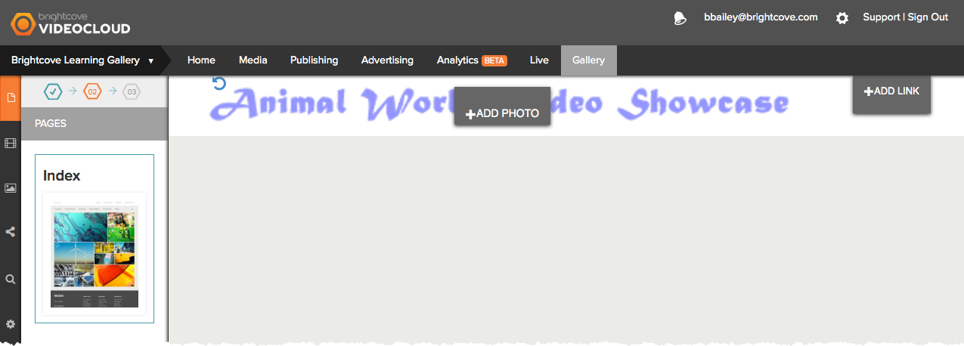
Adding Text
Changes made to the page will appear real-time

Slide 21
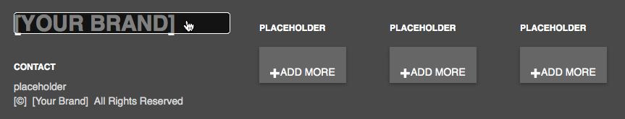
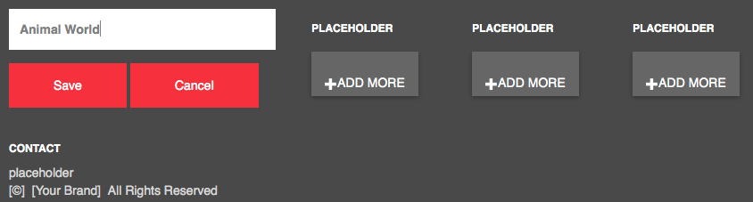
Adding Text
Click a text placeholder
Enter the text

Slide 22
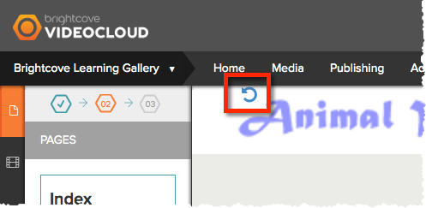
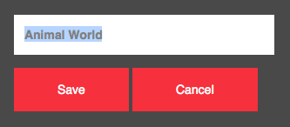
Deleting Objects
Click chasing arrows to remove an image
Clear text and then Save

Slide 23
Adding Video to a Site

Slide 24
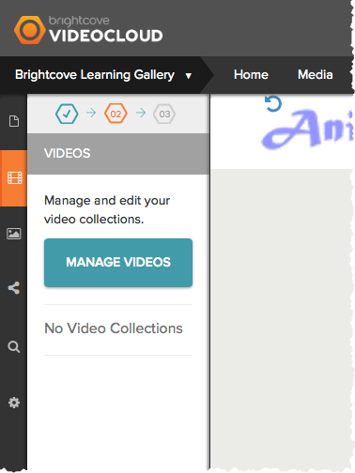
Adding Video to a Site
Click the Videos icon
Click Manage Videos
Videos are organized into collections

Slide 25
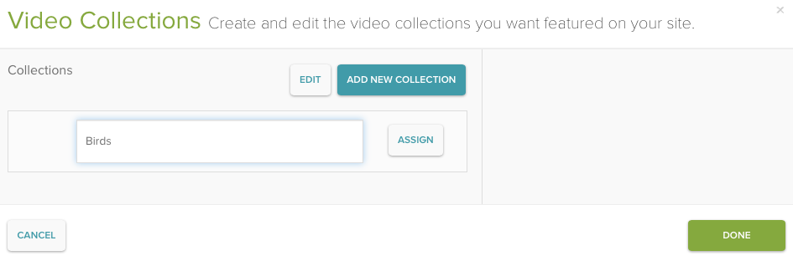
Creating a Collection
Click ADD NEW COLLECTION
Enter name for the collection
Click ASSIGN to assign videos to the collection

Slide 26
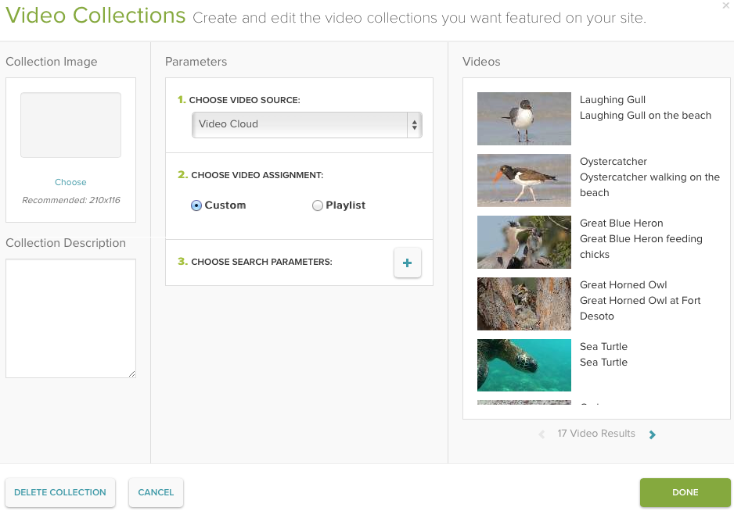
Creating a Collection
Choose a video assignment
Custom
Videos added to the collection based upon tags, search terms or custom fields
Playlist
Videos added to collection based upon playlist

Slide 27
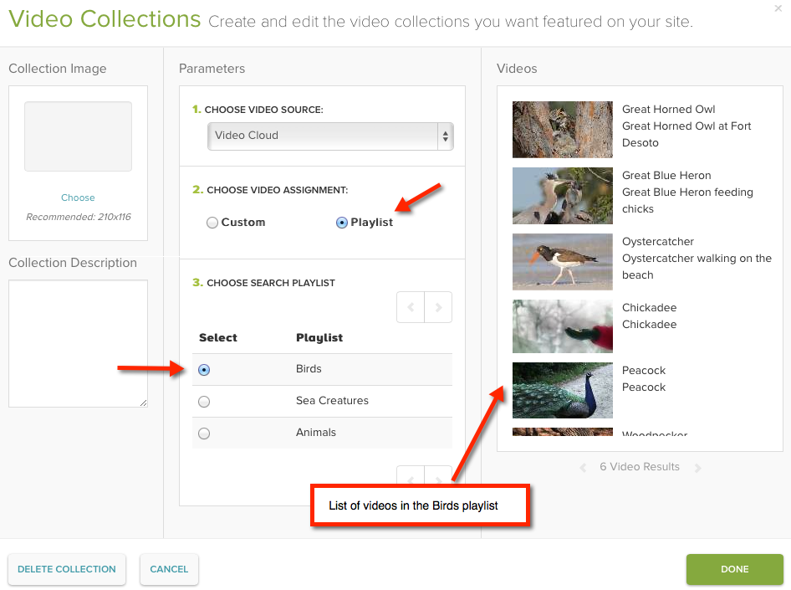
Using a Playlist Video Assignment
Select Playlist
List of playlists in your Video Cloud account will display
Select a Playlist to use
Video list will display videos in that playlist

Slide 28
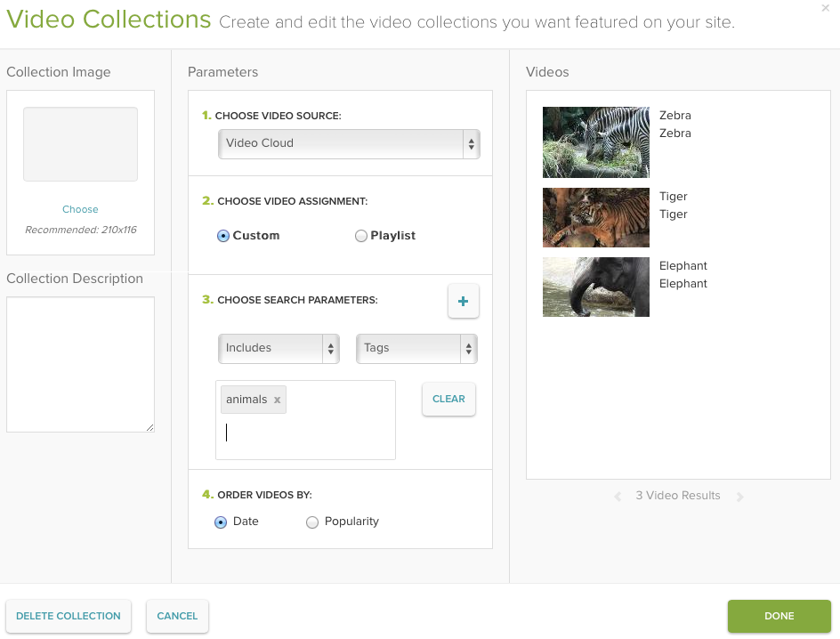
Using a Custom Video Assignment
Select Custom
Add search parameters to select videos for the collection
Multiple search parameters are supported
(Optional) Order videos

Slide 29
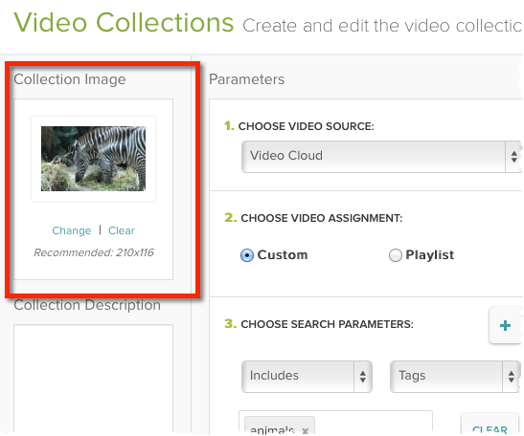
Using a Collection Image
Select an image to use to represent the collection

Slide 30
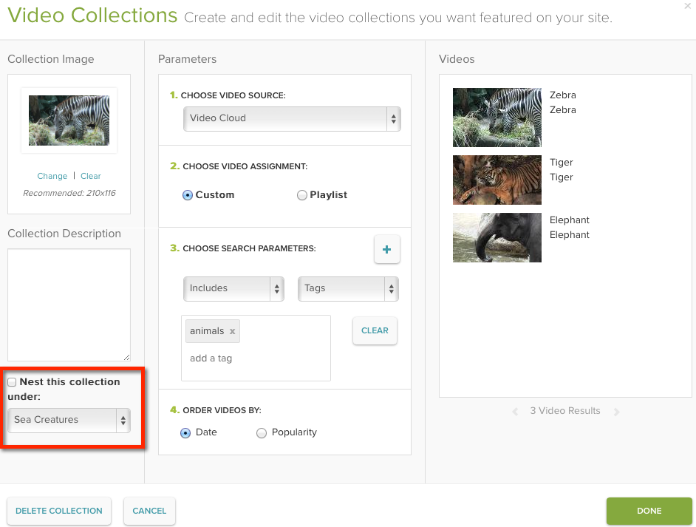
Nesting Collections
Nest a collection under another collection
Not all templates support nested collections

Slide 31
Setting Site Properties

Slide 32
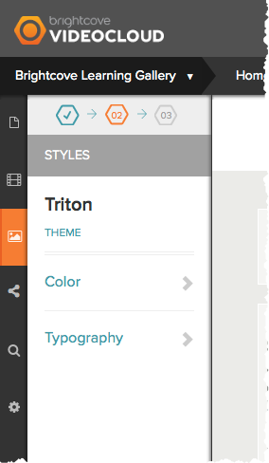
Setting Styles
Click the Styles icon
Change:
Theme
Color
Fonts

Slide 33
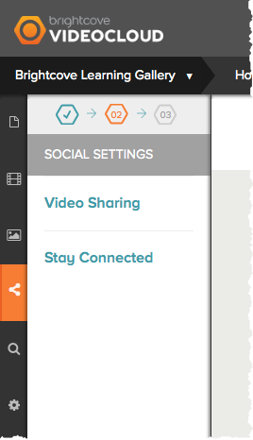
Setting Social Settings
Click the Social Settings icon
Video Sharing
Stay Connected

Slide 34
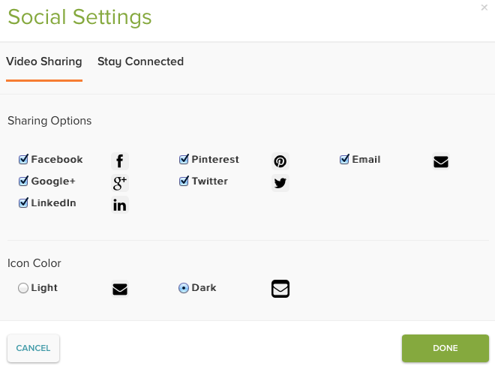
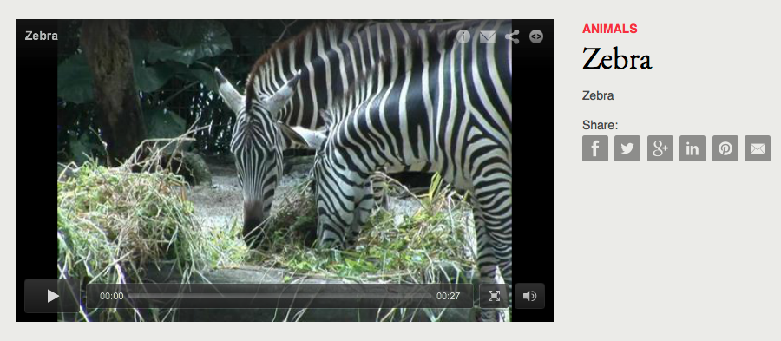
Setting Video Sharing Settings
Video Sharing settings allow viewers to share your videos out to social media sites

Slide 35
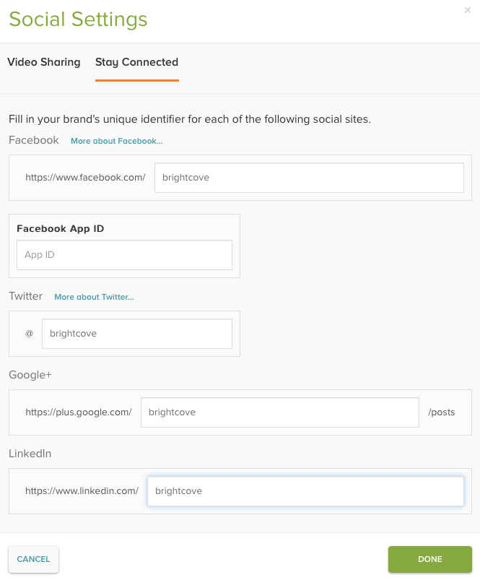
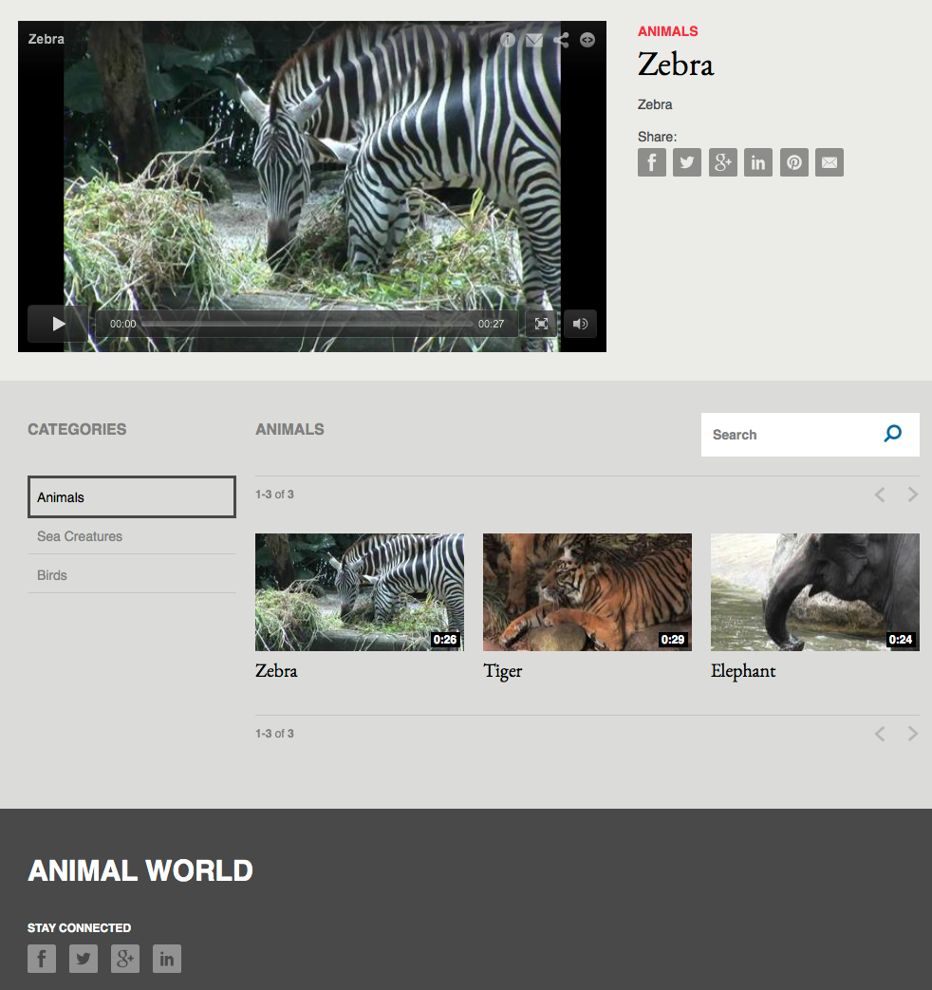
Setting Stay Connected Settings
Stay Connected settings provide viewers with easy access to your social media sites

Slide 36
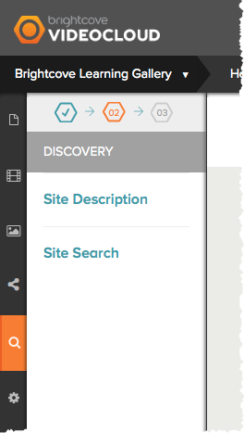
Setting Discovery Settings
Click the Discovery icon
Site Description
Site Search

Slide 37
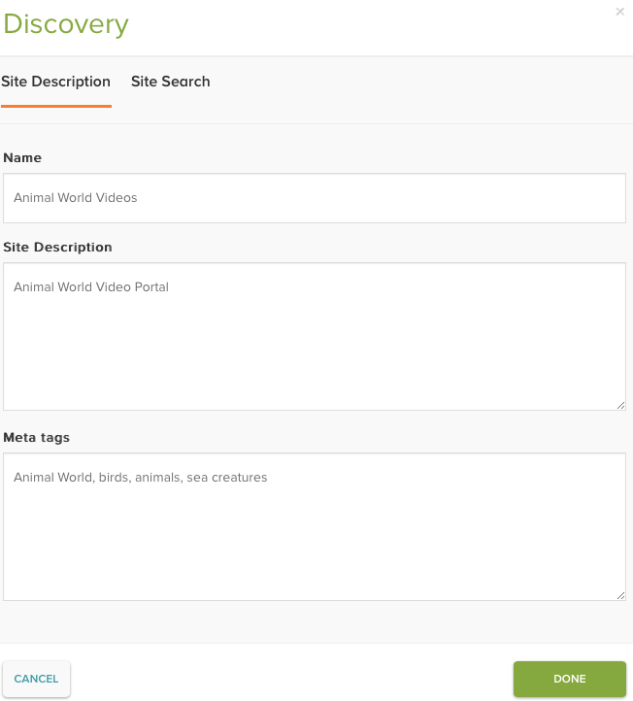
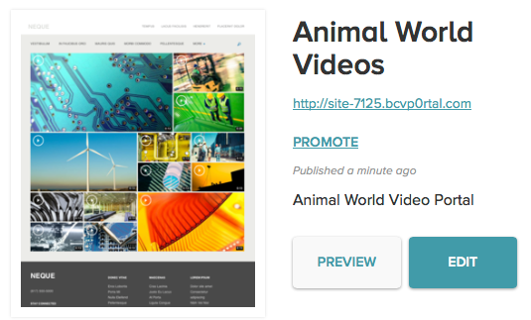
Setting Site Description Settings
Set the site name, description and keywords
Site name
Appears in browser title
Added to site thumbnail
Site Description
Added to site thumbnail
Meta tags
Added to <meta name=“keywords”> for page

Slide 38
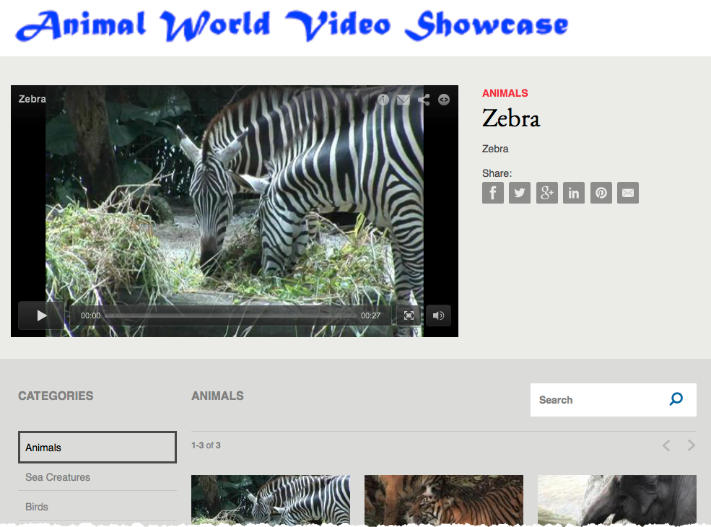
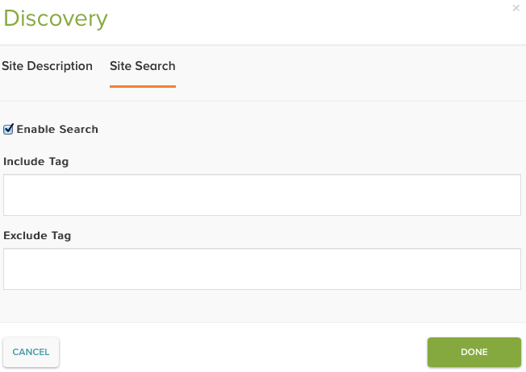
Setting Site Search Settings
Enable the ability for users to search the site
Include Tag – videos must also have this tag to be returned in search results
Exclude Tag – videos with this tag will be excluded from search results
Only a single tag is supported

Slide 39
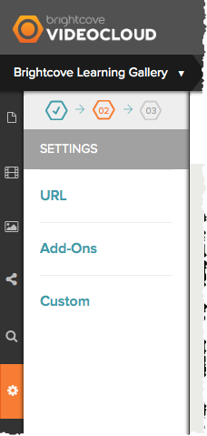
Setting General Settings
Click the Settings icon
URL
Add-Ons
Custom

Slide 40
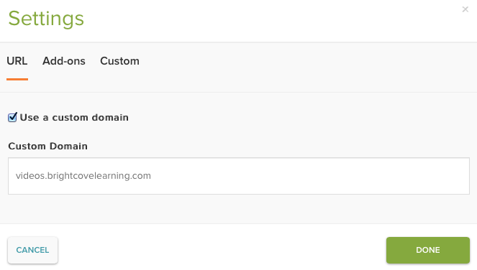
Setting URL Settings
Used to access the site using a custom domain
To use a custom domain you must:
Configure the domain settings in Gallery
Configure a CNAME record for the domain
Domain to access the site at

Slide 41
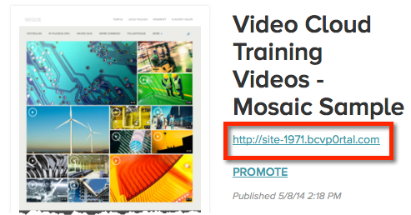
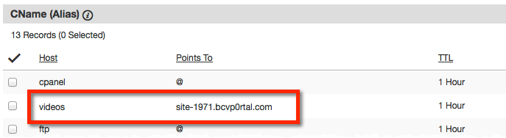
Configuring a CNAME record
Process will be different depending on the domain registrar
Example:
To host site at videos.mysite.com
Set Host to videos
Set Points To to the Gallery site URL
Site URL appears with the site thumbnail
DNS changes may take up to 48 hours to appear

Slide 42
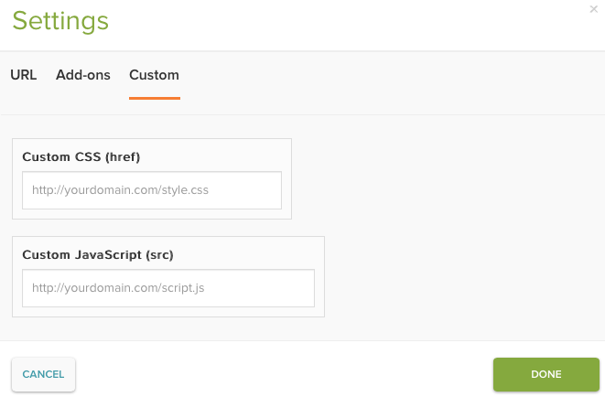
Setting Custom Settings
Provides the ability to use a custom JavaScript or CSS file

Slide 43
Previewing & Publishing a Site

Slide 44
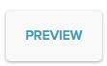
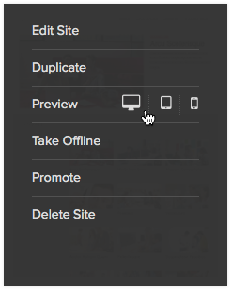
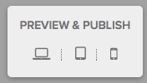
Previewing a Site
Click PREVIEW from Gallery homepage
Hover over the site thumbnail and click Preview
Click PREVIEW & PUBLISH inside of the Gallery Site Editor

Slide 45
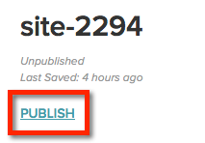
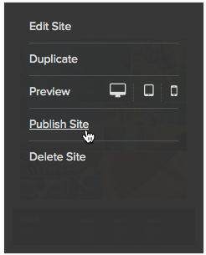
Publishing a Site
Click PUBLISH from Gallery homepage
Hover over the site thumbnail and click Publish Site
Click PREVIEW & PUBLISH inside of the Gallery Site Editor

Slide 46
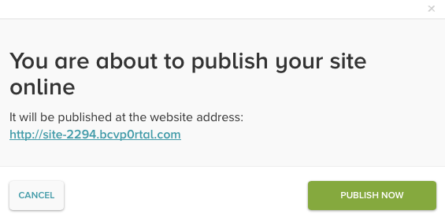
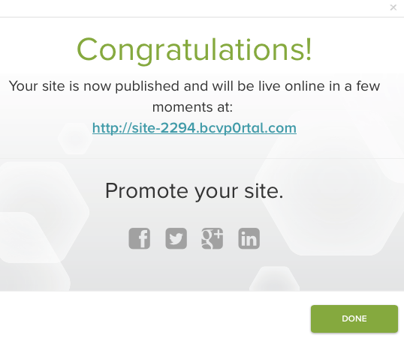
Publishing a Site
Publishing a site generates a static URL for the site so viewers can access it

Slide 47

Publishing a Site
If you make any changes to the site, make sure to republish

